Slide 1
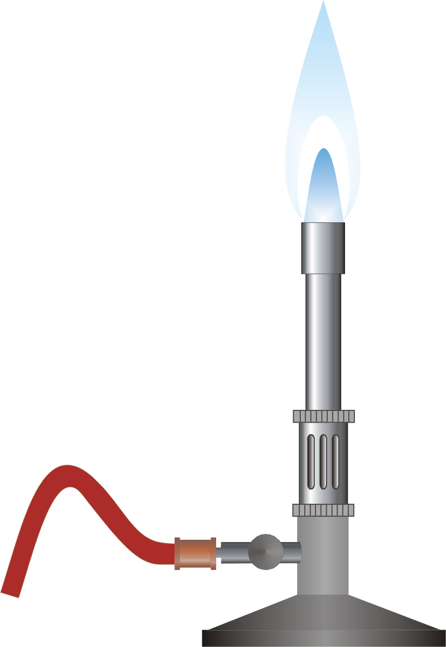

Burner Check
Solution
Technical Development Program SPREAD 2016

Slide 2
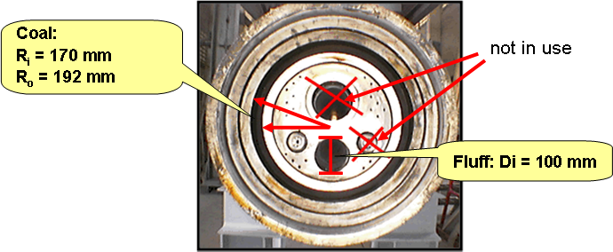
Burner Check Case Study - SOLUTION
Purpose: Get familiar with the Burner Check Tool
Tasks
You made a Burner Check during the heat balance and filled out the spreadsheet already. The only thing that is missing for the evaluation is completing the spreadsheet with the dimensions of the coal and fluff channel dimensions of the burner. Use the information below and fill it in the burner check so that you get the fuel injection velocities. Solution:

Slide 3
Burner Check Case Study - SOLUTION
Assess the results of the Burner Check and compare them with the guidevalues. Do you have suggestions to change/improve the burner setting? Burner Impulsion is low with 6.8 N/MW Injection velocity and fuel load of coal/petcoke is ok with 27 m/s and 3.8 kg/m3. Excessive fluff transport velocity (43-48 m/s) and injection velocity (52 m/s). Fluff will pass through the flame where low O2 is available and probably not burn-out completely → unburnt particles fall on material bed causing reducing conditions. → Possibility to reduce transport air amount to around 800-900 Nm3/h by blowing-off air (temporary) and pulley change at the transport air blower. High amount of radial air compared to axial air with ratio almost 1:1 (ax/rad/cent = 44%/41%/15%). Or in this case the axial air is strongly throttled (fan velocity 85% and damper position only 70% open) → Wide flame and likely creating double flame. Coal burns out fast (first flame) but petcoke fraction and fluff burn-out takes longer (second flame). → Possibility to increase speed of axial air fan and opening damper to make the flame more narrow and more intensive mixing with secondary air. The impulsion could be increased almost up to 10 N/MW (axial air 4800 Nm3/h, 320 mbar) and the ratio axial/radial air brought more to normal range of 1.5:1 to 2:1. Of course such adjustment needs to be done in smaller steps.

Slide 4
Burner Check Case Study - SOLUTION
(continued) The amount of central air is elevated, making up 15% of the total primary air. Also the pressure is high with 140 mbar. The effect of this is likely cooling the flame core too much and may delay the ignition. Furthermore the higher availability of oxygen in the flame root can lead to increased NOx levels. → Should be tried to throttle the central air with damper to get into more normal range of 5-10% of total primary air and pressures between 40-80 mbar. The “length of fixed coating divided by kiln diameter” is 5.9. This indicates longer flame that causes higher S-volatility. The remaining parameters (not mentioned here) are in normal ranges and do not indicate any specific issue.

Slide 5
Burner Check Case Study - SOLUTION
Understanding the influence of input parameters: - Which key values change in the burner check if you modify the fuel split to calciner to 55% - Which key values change if you modify the heat value of coal/petcoke mix to 29’000 kJ/kg? Changing the fuel split does only change the calculated heat consumption. All the key figures of the burner remain unchanged as the thermal input to main burner stays the same (given by fuel rate and NCV of fuel). Change of the coal/petcoke heat value affects the heat consumption and all the specific burner parameters (impulsion, % primary air, thermal load BZ) → therefore it is important to have correct fuel inputs (NCV, t/h)

Slide 6
Burner Check Case Study - SOLUTION
A colleague mentioned that wrong alignment could have a negative effect on the S-volatility. What are the basic settings for alignment and how can you verify if the burner is correctly aligned? If the flame is too close to the material bed it can generate local reducing conditions and provoke unburnt fuel particles to fall onto the material bed. The basic alignment is to have the burner centered in the kiln. Furthermore the burner should be aligned in kiln axis. This can be verified by an inclinometer (placed on a representative surface of the burner) or by placing a laser in the burner and see where the laserpoint hits the kiln (hit point of the laser with aligned burner is the center of the kiln inlet)
Note as well: If the flame is pointing strongly upwards there can also be a higher risk of overheating the refractory (hot spots)

Slide 7
Burner Check Case Study - SOLUTION
(continued) The insertion of the burner tip inside the kiln has also an effect on the flame length. The insertion distance is measured from the kiln outlet (nose ring) to the tip of the burner). A rough rule of thumb is that with each 10cm the tip pushed into the kiln, the flame will get 1m longer. So if the burner is inserted very much inside the kiln it can produce a longer flame that leads to higher S-volatility. Typical range of insertion of the tip is between 0 and 1m inside the kiln (kilns with grate cooler and preheater/precalciner tower). If no experience from the past is available a good starting point would be to insert the burner 0.2 to 0.5 m inside the kiln (in cold condition).

Slide 8
Burner Check Case Study - SOLUTION
Message
Check that the fuel and process information you enter in the Burner check are correct (fuel feed rates, heat values, fuel split). Cross-check the measured primary air flows and transport air flows with the specifications from fans and blowers.
You have to interpret the results of the burner check always in relation with many different parameters of kiln operation and quality (e.g. S-volatility, microscopy, kiln shell scanner, kiln inlet temperature, kiln inlet O2, CO and NOx).
Optimize the burner settings for your fuel mix
Check the Sheet “Detailed Guidelines” with more information about Burner design, upgrades, etc. - and seek for more information in the Burner Manual

